Slide 1
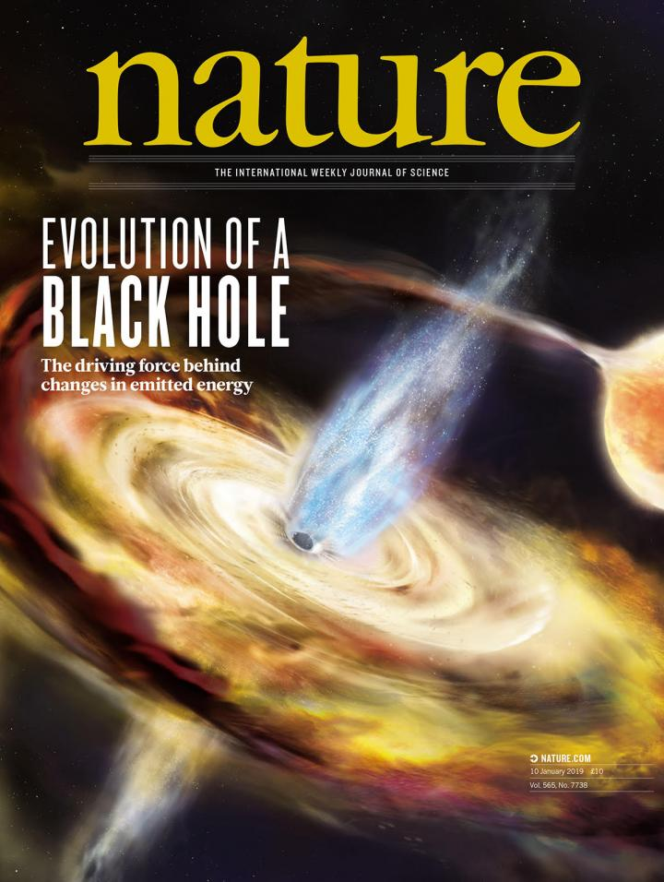
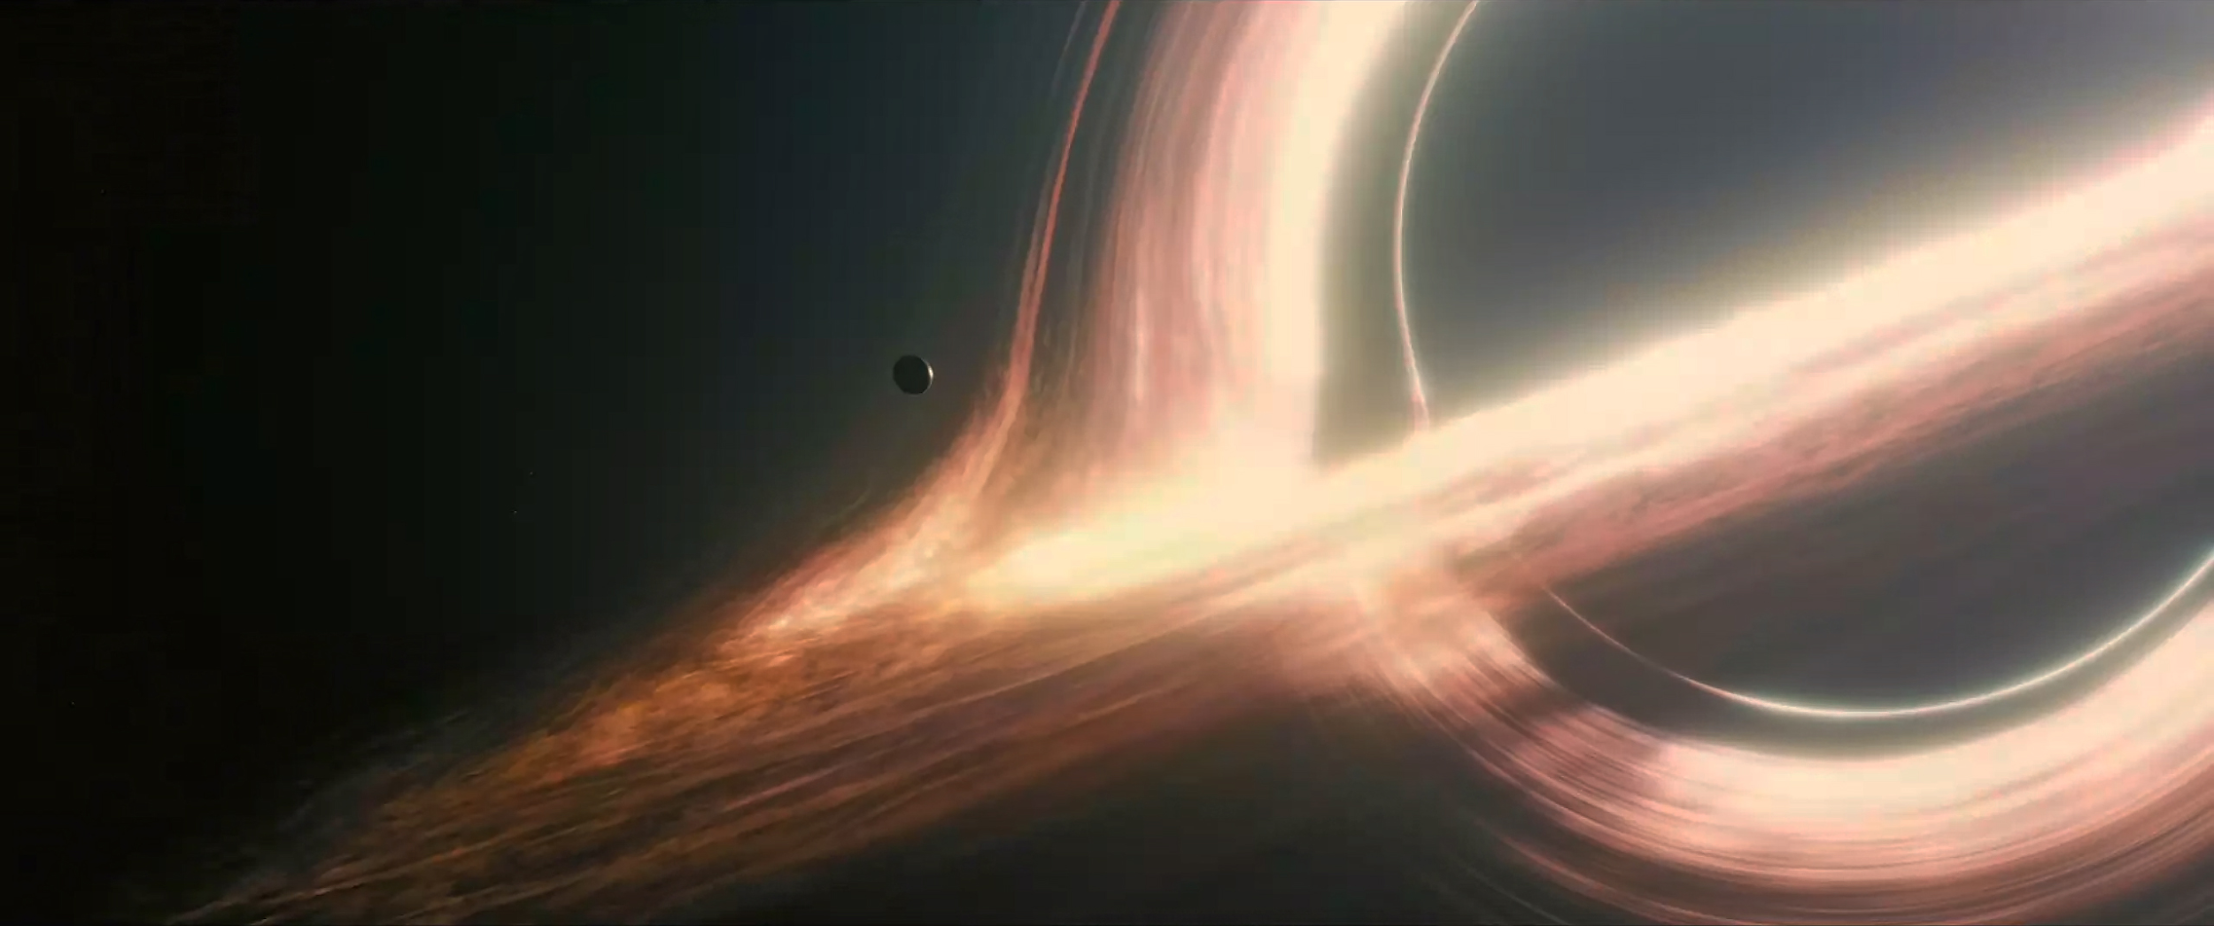
Black Holes
Ethan Partington
Wayne State Planetarium

Slide 2
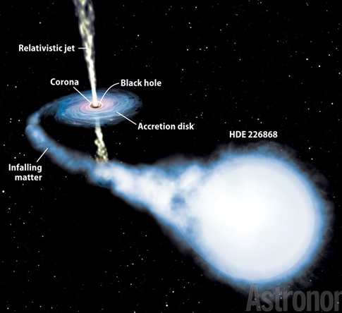
Cygnus X-1
Discovered 1964 (X-ray Source)
Confirmed black hole 1971
(Observation of binary companion)
Distance: 6,000 ly away
Mass: 14.8 M☉
(1 M☉ = 1.99 x 10³⁰ kg)

Slide 3
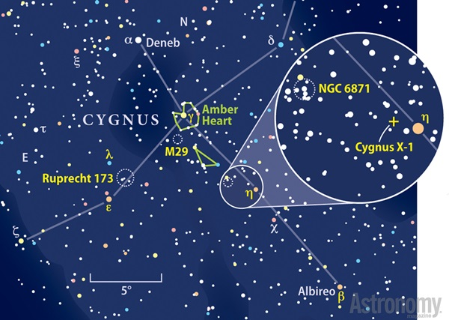

Slide 4
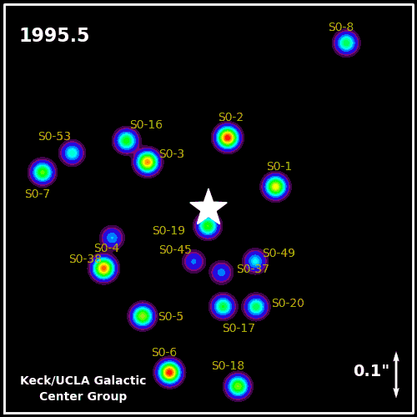
Sagittarius A*
Discovered 1931 (Radio Source)
Confirmed black hole 2018
(Motion of central stars and gas - Won 2020 Nobel Prize!)
Distance: 26,700 ly away
Mass: 2.6 million M☉

Slide 5
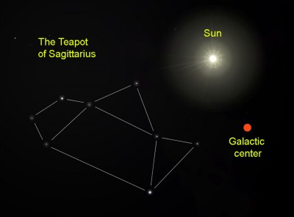

Slide 6
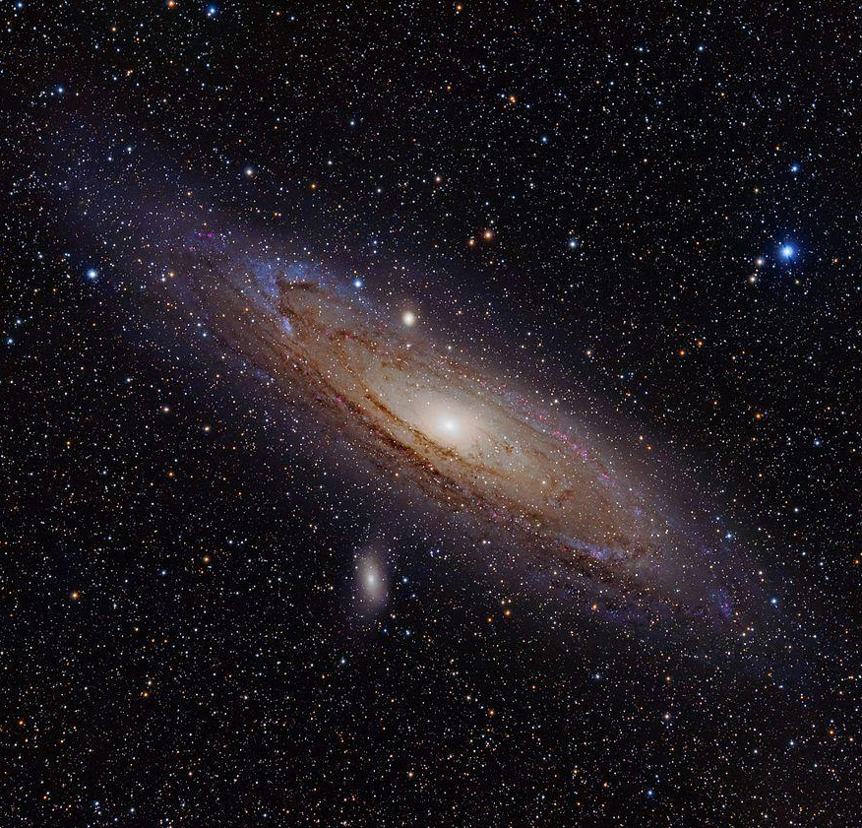
Andromeda Galactic Center
First recorded 964 AD
Confirmed black hole 1984
(Motion of central stars)
Distance: 2.5 million ly away
Mass: 110-230 million M☉

Slide 7
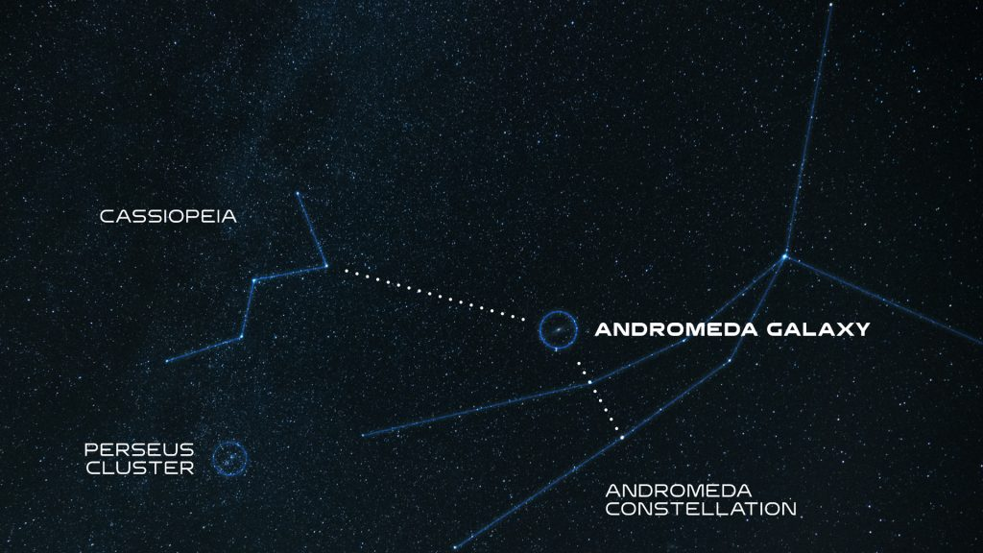

Slide 8
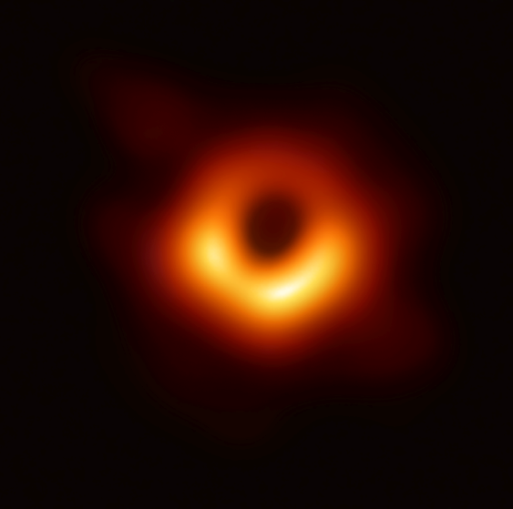
M87 Galactic Center
Discovered 1781 (Nebulous feature)
Confirmed black hole 1978
(Motion of central stars)
Photographed 2019
Distance: 53.5 million ly away
Mass: 6.5 billion M☉

Slide 9
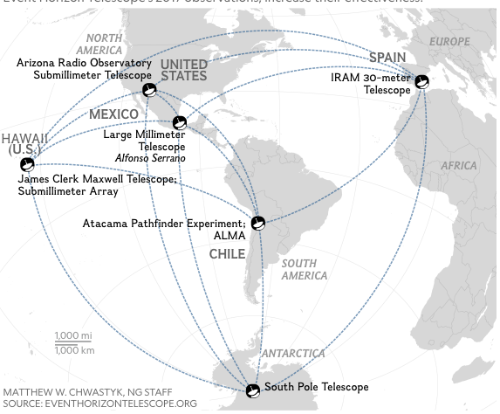
Event Horizon Telescope Array

Slide 11
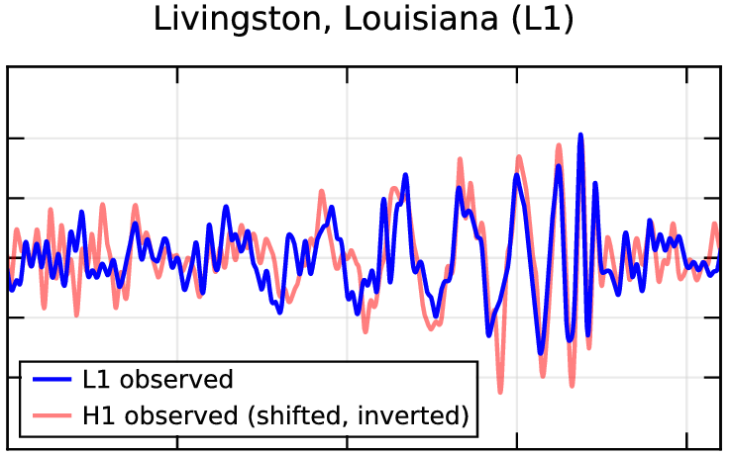
GW150914
Discovered 2015
Confirmed black hole 2015
(Numerical relativity simulations)
Distance: 800-1800 million ly away
Mass: 36+29 M☉

Slide 12
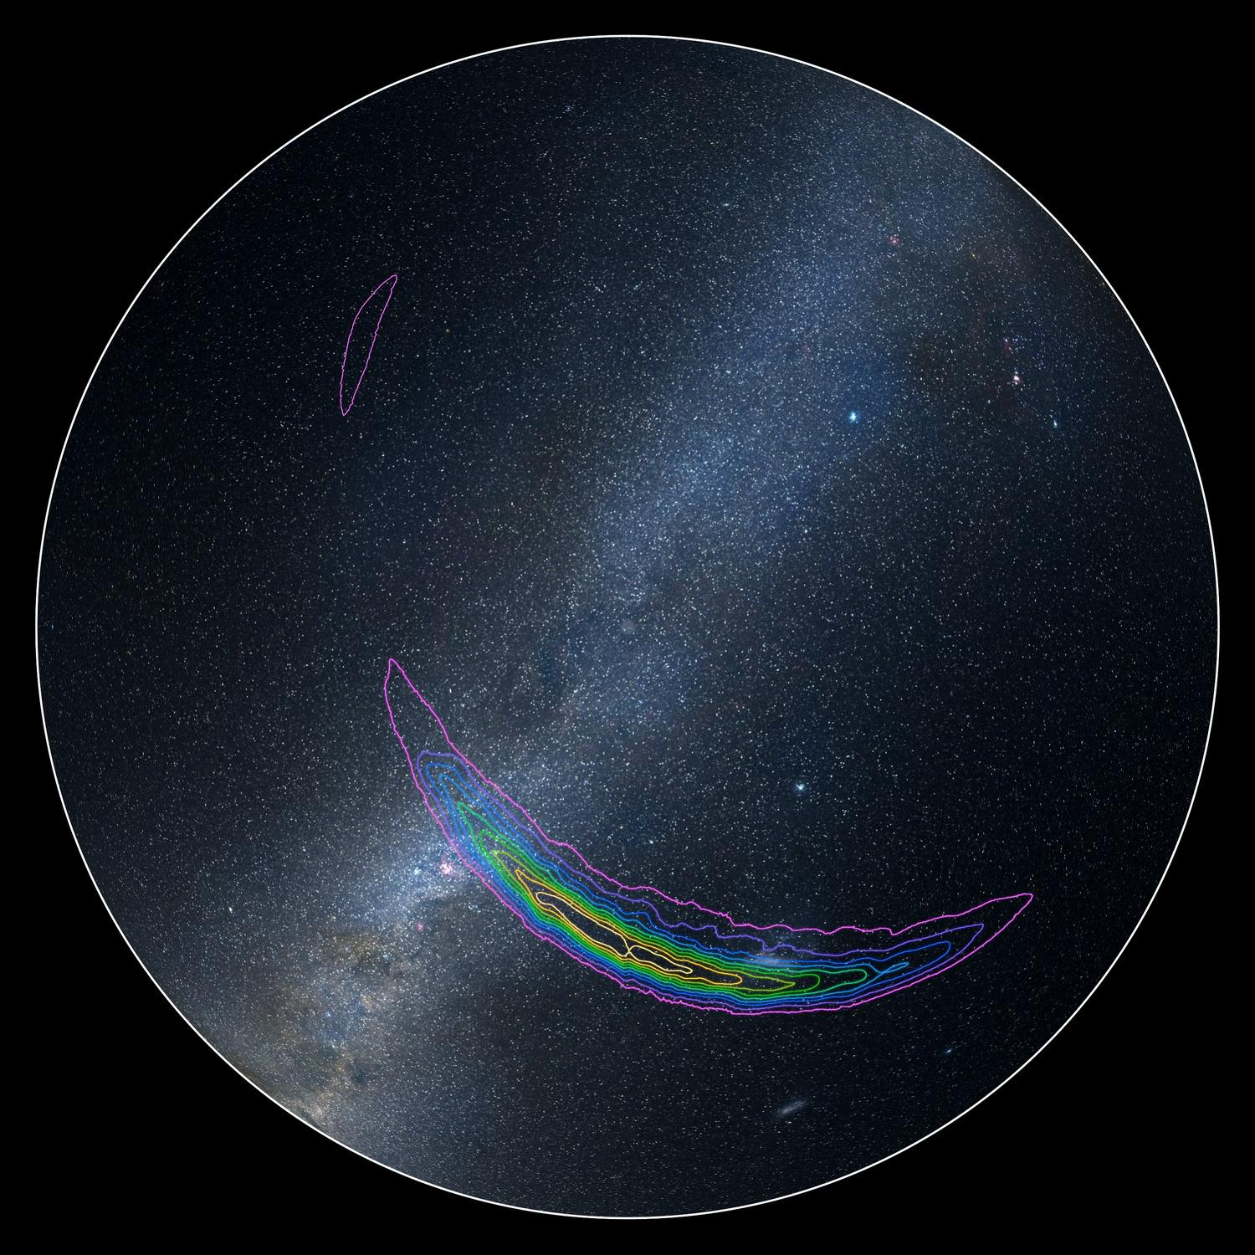

Slide 13
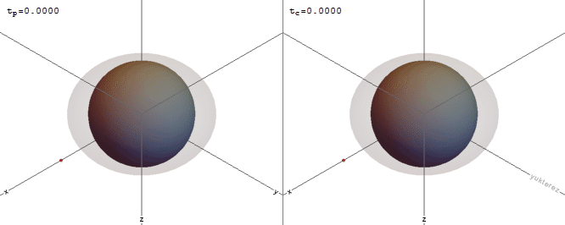
What happens as you approach a black hole?
Gravitational Time Dilation
Gravitational field strength affects the flow of time
As you get closer, you’d appear to slow down to an observer
From your perspective, the observer appears to age very quickly
By Yukterez - kerr.yukterez.net

Slide 14
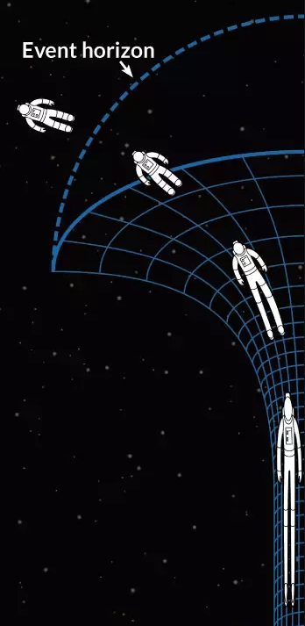
What happens as you approach a black hole?
Spaghettification
Gravitational field strength increases when objects are close together
As you cross the event horizon, the distance between your head and your feet creates a significant difference in gravitational force
This causes your body to become stretched by gravity, like spaghetti

Slide 15
Bonus: Milkdromeda Merger
ETA: 4.5 billion years

